Slide 1
Time Wasters on Social Media
Data Analysis and Visualization Project Report
Submitted by: Jordan R Sawkmie (24PGDDA16)

Slide 2
CONTENT / INDEX
Introduction
Objective
Data Description
Data Cleaning
Data Visualisation
Data Analysis
Key Takeaways
Recommendations
Conclusion

Slide 3
Introduction
In recent years, social media platforms have revolutionized how people interact, communicate, and consume content. However, concerns arise about productivity, mental health, and personal growth impacts. This study explores behavioral patterns and provides actionable insights into balancing benefits and challenges.

Slide 4
Objective
- Analyze user behavior on social media platforms.
- Identify patterns in time spent and demographic trends.
- Assess impacts on productivity and satisfaction.
- Understand motivations behind social media consumption.
- Propose recommendations to mitigate excessive usage.

Slide 5
Data Description
1,000 entries with 23 attributes, including:
Demographics (Age, Gender, Country, Profession).
Platform Usage (Instagram, Facebook, TikTok, YouTube).
Content Interaction: Total time spent, number of videos watched, time spent per video, video category, and perceived usefulness.
Behavioral Metrics (Productivity loss, satisfaction levels).
Temporal Patterns (Watch time and activity during usage).

Slide 6
Data Cleaning
Verified no missing data; dataset was complete.
Standardized categorical values and corrected data types.
Checked for outliers and ensured consistency.
Duplicates: Confirmed that there were no duplicate records.

Slide 7
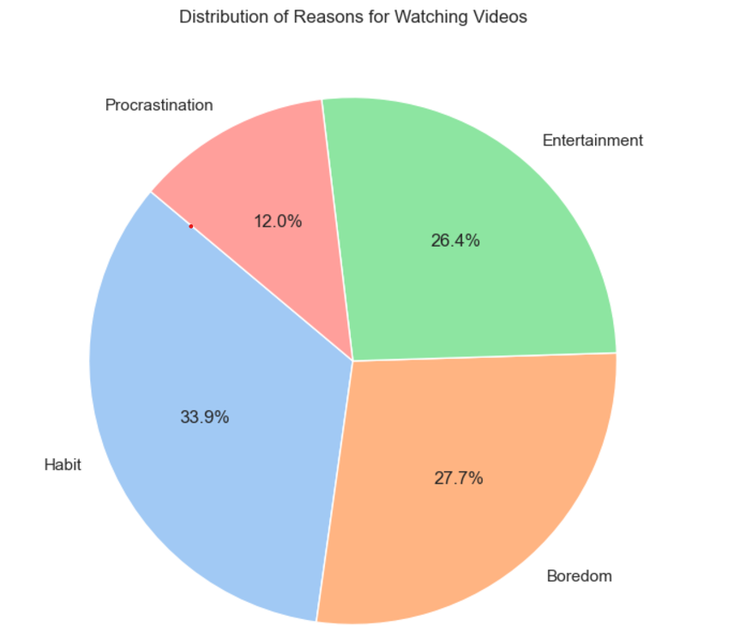
The pie chart provides a visual representation of the distribution of reasons for watching videos. The chart illustrates four main categories with their respective proportions:

Slide 8
The largest proportion (33.9%) points to video-watching being a habitual activity. This suggests that many people have integrated video consumption into their daily routines, possibly as a default behavior.
Nearly 28% of people use videos to combat boredom, indicating that video platforms serve as a significant tool for unstructured time management. This emphasizes the role of videos in catering to idle moments.
With 26.4%, entertainment remains a primary driver of video consumption. This reinforces the importance of engaging and enjoyable content to capture audiences.
At 12%, procrastination represents a minor reason compared to the other categories. This suggests that while some people use videos as a distraction from responsibilities, it is not the primary motivator for most viewers

Slide 9
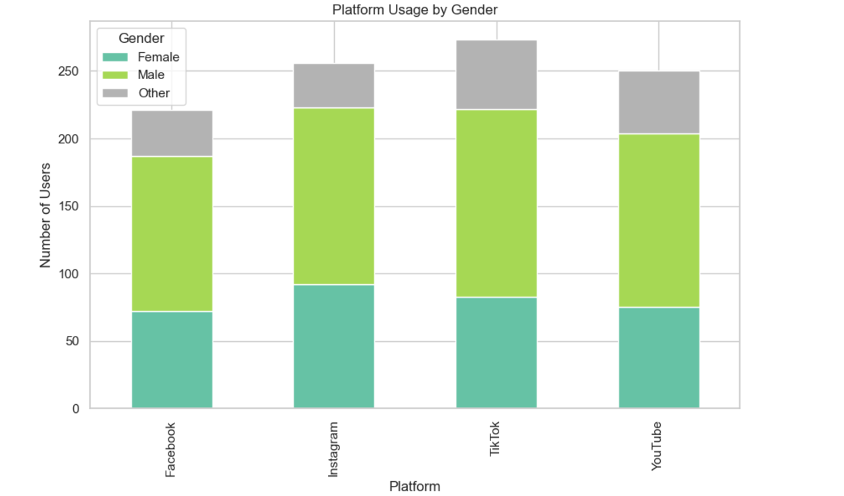
The bar chart visualizes platform usage by gender across four social media platforms: Facebook, Instagram, TikTok, and YouTube. Each bar is segmented to represent the gender categories—Female, Male, and Other—with the number of users on the y-axis. Key observations include:

Slide 10
Across all platforms, male users form the largest group. This suggests that platform content or advertising strategies may be more tailored to or consumed by this demographic.
While male users dominate, platforms like Instagram and TikTok show relatively higher participation from female users compared to Facebook and YouTube. TikTok, in particular, has a more balanced representation, indicating it appeals to a broader demographic.
The "Other" gender group maintains a consistent, smaller proportion across all platforms. While small, this segment highlights the growing recognition and representation of non-binary or non-traditional gender identities.
Facebook: Maintains a male-centric user base, possibly indicating an older audience demographic with gender-specific preferences.
Instagram: Shows more engagement from diverse gender groups, aligning with its younger, visually-driven audience
TikTok: Demonstrates a stronger appeal to a balanced gender demographic, highlighting its interactive and diverse content offerings.
YouTube: Follows Facebook’s trend with male dominance but retains a steady audience across other gender groups.

Slide 11
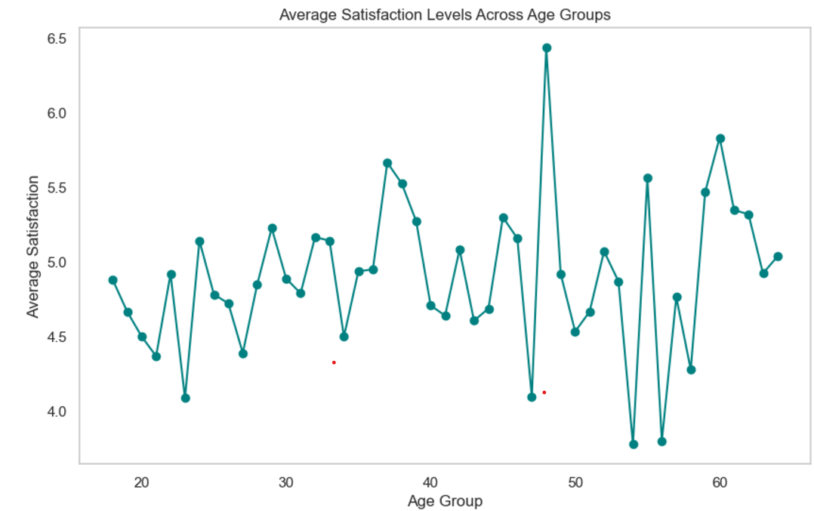
The line chart depicts average satisfaction levels across age groups. The x-axis represents the age groups, while the y-axis shows the corresponding average satisfaction levels. Each data point connects to form a trend line, offering a visual overview of how satisfaction levels fluctuate with age.

Slide 12
Satisfaction levels display significant fluctuations across age groups, rather than following a steady trend.
Peaks and troughs are visible, indicating varying levels of satisfaction among different age demographics
Satisfaction levels are relatively stable but slightly lower on average compared to other age groups.
This could reflect transitional life stages like career beginnings or other uncertainties.
A sharp peak in satisfaction is observed, followed by sudden drops. The peak suggests a period of contentment, possibly related to career stability or personal achievements.
Satisfaction levels begin to stabilize but show gradual decline in later years, possibly due to health concerns or retirement-related changes.
Specific spikes and dips at certain age groups suggest life events or factors unique to those demographics may strongly influence satisfaction (e.g., mid-life crisis, retirement, or personal achievements).

Slide 13
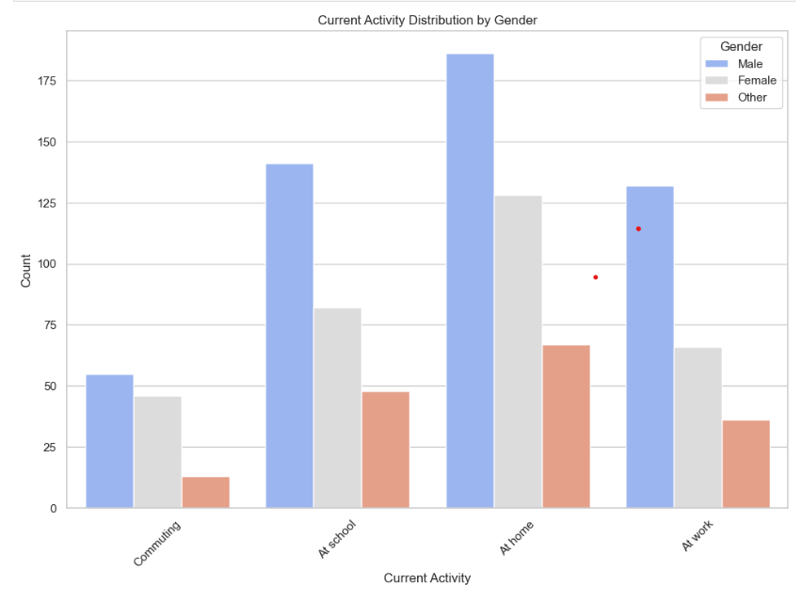
The bar chart visualizes the distribution of Current Activities (such as commuting, being at school, at home, or at work) across different genders(Male, Female, Other).

Slide 14
Males are consistently higher in counts across all activities, particularly At Home and At Work.
Females are significantly represented in At Home but slightly lower in activities like At Work and At School.
The "Other" category has the lowest counts across all activities, with a relatively uniform but limited presence.
At Home is the dominant activity, possibly reflecting leisure time or work-from-home trends.
At Work remains significant, highlighting traditional workplace engagement.
Lower counts for Commuting might indicate a shift toward remote work/study or a population not engaged in frequent travel.

Slide 15
Key Findings - Data Visualization
Younger demographics favor Instagram and TikTok, while older users gravitate toward Facebook and YouTube. These preferences reveal how platforms cater to varied age groups, offering distinct content and engagement mechanisms.
Urban users show a higher affinity for dynamic platforms like Instagram, whereas rural areas lean toward content-rich platforms such as YouTube
Entertainment-focused content, while widely consumed, shows a higher correlation with addiction scores compared to educational content.
Boredom and entertainment are key drivers of usage, particularly among younger individuals. These reasons often correlate with procrastination and diminished productivity, especially for students and professionals.
The lack of educational content consumption underscores a potential gap in leveraging social media for skill development and self-improvement.

Slide 16
Recommendations
- Introduce structured time limits using monitoring tools.
- Encourage skill-building and educational content.
- Platforms should promote mindful usage features.
- Educators and policymakers to integrate social media literacy.

Slide 17
Conclusion
While social media offers unparalleled opportunities for connection and knowledge sharing, its unregulated use presents risks that demand attention. Striking a balance between beneficial engagement and avoiding detrimental effects is essential for maximizing its value. This study underscores the importance of informed strategies to navigate this ever-evolving digital landscape effectively
This study provides a comprehensive overview of social media usage patterns, highlighting significant behavioural trends, platform preferences, and associated impacts. The key findings emphasize the growing role of social media in daily life while also shedding light on challenges related to excessive usage.

